Slide 1
Module 5.2: Deep Neural Network
Dennis J. Zhang
Washington University in St. Louis

Slide 2

What is Deep Learning
A machine learning subfield of learning representations of data. Exceptional effective at learning patterns.
Deep learning algorithms attempt to learn (multiple levels of) representation by using a hierarchy of multiple layers
If you provide the system tons of information, it begins to understand it and respond in useful ways.
https://www.xenonstack.com/blog/static/public/uploads/media/machine-learning-vs-deep-learning.png

Slide 3
Decision Boundary
0 hidden layers: linear classifier
Hyperplanes
Example from to Eric Postma via Jason Eisner

Slide 4
Decision Boundary
1 hidden layer
Boundary of convex region (open or closed)
Example from to Eric Postma via Jason Eisner
Notes:
We saw with XOR

Slide 5
Decision Boundary
2 hidden layers
Combinations of convex regions
Example from to Eric Postma via Jason Eisner

Slide 6
Deeper Network
Output
y
Hidden Layer 1
a₁
a₂
…
a_{D}
Input
x₁
x₂
x₃
…
x_{M}

Slide 7
Deeper Network
Output
y
Hidden Layer 2
b₁
b₂
…
b_{E}
Hidden Layer 1
a₁
a₂
…
a_{D}
Input
x₁
x₂
x₃
…
x_{M}

Slide 8
Deeper Network
Making the neural networks deeper
Output
y
Hidden Layer 3
c₁
c₂
…
c_{F}
Hidden Layer 2
b₁
b₂
…
b_{E}
Hidden Layer 1
a₁
a₂
…
a_{D}
Input
x₁
x₂
x₃
…
x_{M}

Slide 9
Neural Network Helps Abstraction
We don’t know the “right” levels of abstraction
So let the model figure it out!
Example from Honglak Lee (NIPS 2010)
Notes:
TODO: Make pixels greyscle
TODO: Increase size of 1st hidden layer

Slide 10
Neural Network Helps Abstraction
Face Recognition:
Deep Network can build up increasingly higher levels of abstraction
Lines, parts, regions
Example from Honglak Lee (NIPS 2010)
Notes:
TODO: Make pixels greyscle
TODO: Increase size of 1st hidden layer

Slide 11
Neural Network Helps Abstraction
Output
y
Hidden Layer 3
c₁
c₂
…
c_{F}
Hidden Layer 2
b₁
b₂
…
b_{E}
Hidden Layer 1
a₁
a₂
…
a_{D}
Input
x₁
x₂
x₃
…
x_{M}
Example from Honglak Lee (NIPS 2010)

Slide 12
Deep Learning is better?
Layer X Size | Word Error Rate (%) | Layer X Size | Word Error Rate (%)
1 X 2k | 24.2
2 X 2k | 20.4
3 X 2k | 18.4
4 X 2k | 17.8
5 X 2k | 17.2 | 1 X 3772 | 22.5
7 X 2k | 17.1 | 1 X 4634 | 22.6
 |  | 1 X 16k | 22.1
Not surprised, more parameters, better performance
Seide, Frank, Gang Li, and Dong Yu. "Conversational Speech Transcription Using Context-Dependent Deep Neural Networks." Interspeech. 2011.
Notes:
SWB
For a fixed number of parameters, a deep model is clearly better than the shallow one.

Slide 13
Depth vs Width
Layer X Size | Word Error Rate (%) | Layer X Size | Word Error Rate (%)
1 X 2k | 24.2
2 X 2k | 20.4
3 X 2k | 18.4
4 X 2k | 17.8
5 X 2k | 17.2 | 1 X 3772 | 22.5
7 X 2k | 17.1 | 1 X 4634 | 22.6
 |  | 1 X 16k | 22.1
Seide, Frank, Gang Li, and Dong Yu. "Conversational Speech Transcription Using Context-Dependent Deep Neural Networks." Interspeech. 2011.

Slide 14
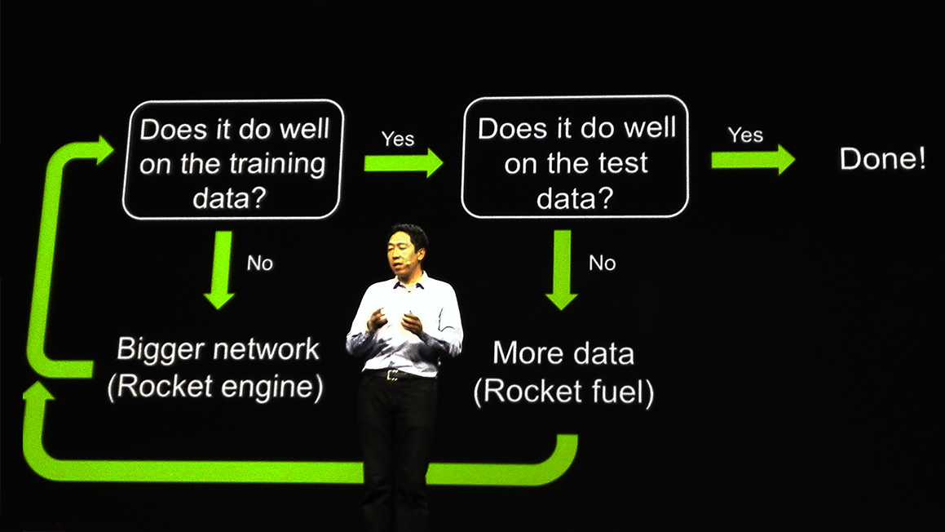
Recipe for Deep Learning
http://www.gizmodo.com.au/2015/04/the-basic-recipe-for-machine-learning-explained-in-a-single-powerpoint-slide/
Notes:
今年四月的 GTC

Slide 15
Recipe for Deep Learning
Don’t forget!
overfitting
Modify the Network
Preventing
Overfitting
Better optimization Strategy
http://www.gizmodo.com.au/2015/04/the-basic-recipe-for-machine-learning-explained-in-a-single-powerpoint-slide/
Notes:
Last one is on training set
Sometimes students ask

Slide 16
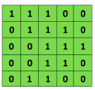

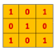
Convolutional Neural Networks (CNN)
Main CNN idea for text:
Compute vectors for n-grams and group them afterwards
Example: “this takes too long” compute vectors for:
This takes, takes too, too long, this takes too, takes too long, this takes too long
Convolutional
3x3 filter
Input matrix
Notes:
http://www.asimovinstitute.org/neural-network-zoo/

Slide 17
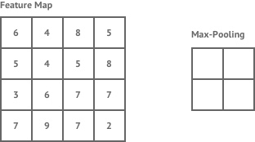
Convolutional Neural Networks (CNN)
Main CNN idea for text:
Compute vectors for n-grams and group them afterwards
max pool
2x2 filters
and stride 2
https://shafeentejani.github.io/assets/images/pooling.gif

Slide 18
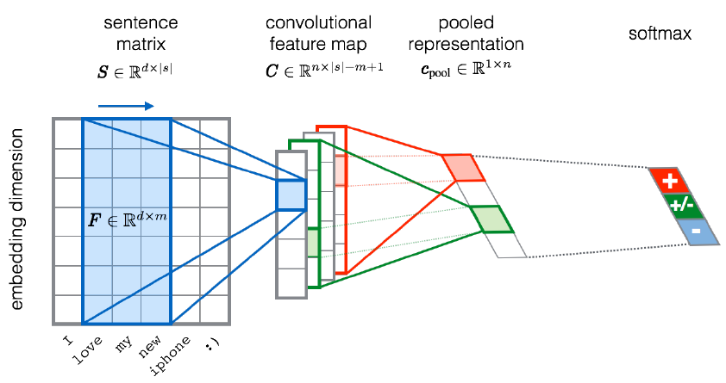
Convolutional Neural Networks (CNN)
Severyn, Aliaksei, and Alessandro Moschitti. "UNITN: Training Deep Convolutional Neural Network for Twitter Sentiment Classification." SemEval@ NAACL-HLT. 2015.
Notes:
the width m of the convolution filters is set to 5
n = 300 feature maps
first layer embeds words into low-dimensional vectors.

Slide 19
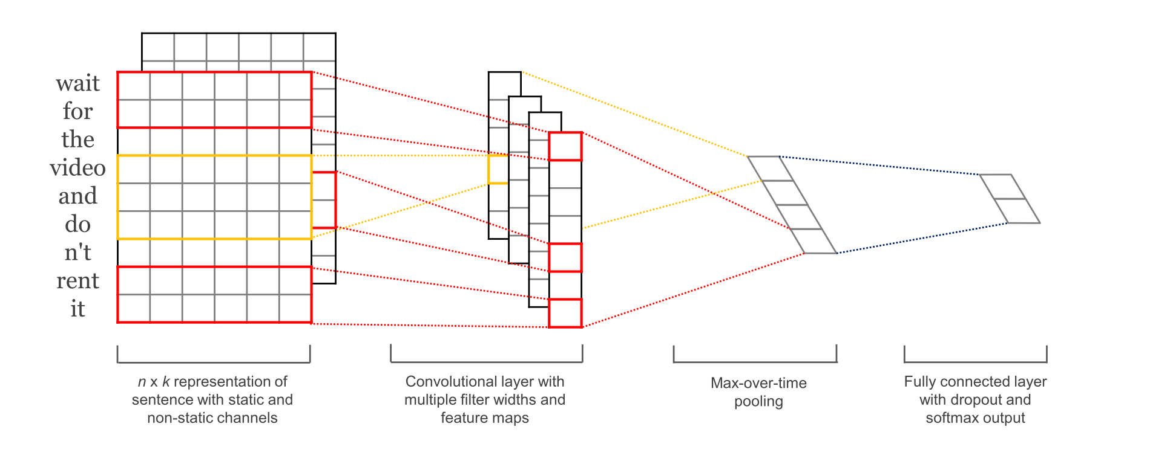
Convolutional Neural Networks (CNN)
Kim, Y. “Convolutional Neural Networks for Sentence Classification”, EMNLP (2014)
sliding over 3, 4 or 5 words at a time

Slide 20
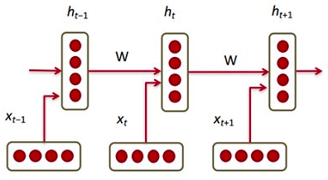
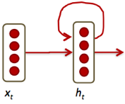

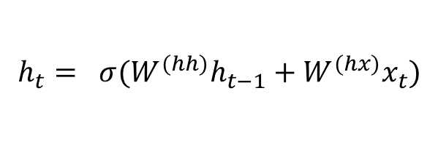

Recurrent Neural Networks (CNN)
Main RNN idea for text:
Condition on all previous words
Use same set of weights at all time steps
$$h_{t}= σ(W^{(hh)}h_{t−1}+W^{(hx)}x_{t})$$
$$≜$$
https://pbs.twimg.com/media/C2j-8j5UsAACgEK.jpg
Stack them up, Lego fun!
Vanishing gradient problem
https://discuss.pytorch.org/uploads/default/original/1X/6415da0424dd66f2f5b134709b92baa59e604c55.jpg
Notes:
https://pbs.twimg.com/media/C2j-8j5UsAACgEK.jpg

Slide 21
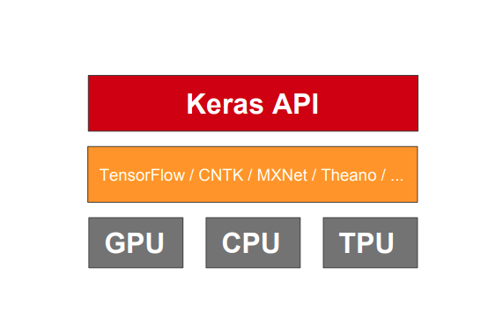
Introduction to Keras

Slide 22
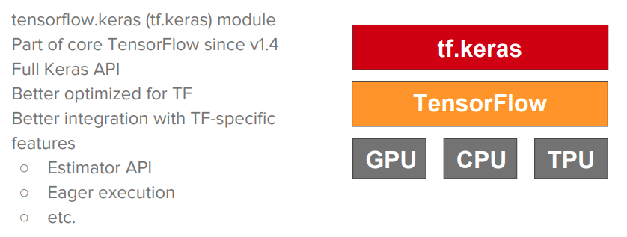
Keras is the official high-level API of Tensorflow

Slide 23

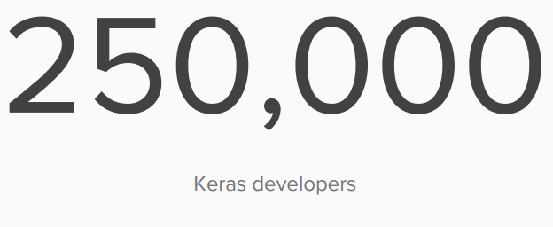
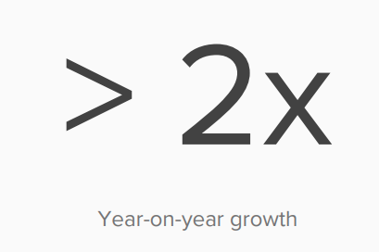
Who contributes to Keras?

Slide 24
How to use Keras
The Sequential Model:
Very simple
Only for single-input, single-output, sequential layer stacks
Good for a majority of cases
The functional API:
Similar to Lego
Multi-input, multi-output, arbitrary static graph topology
Good for almost all casts

Slide 25
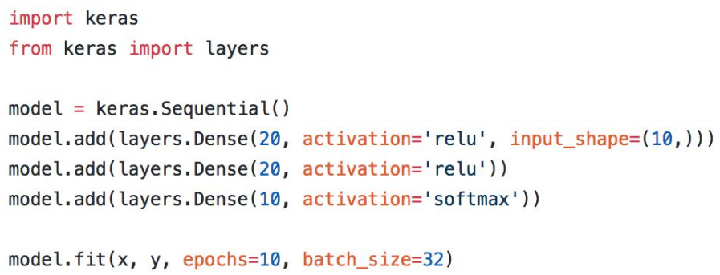
How to use Keras

